Slide 1
Understanding
The Bi-Monthly Bill
& Statement
Presented by Faye French

Slide 2
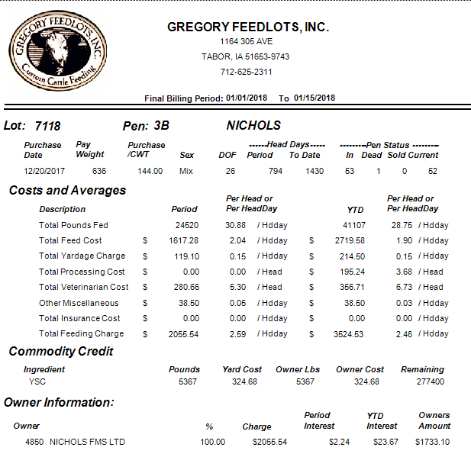
A LOOK AT THE BILL
Billing Period
Lot #
0001
Customer Name
1
2
3
4
Bill Sections
Customer Name

Slide 3
1) BASIC LOT INFORMATION

Slide 4
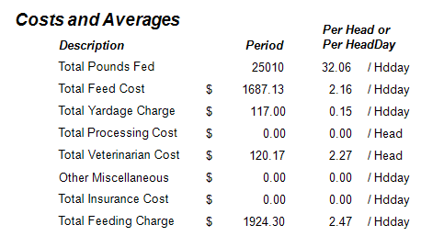
2) Costs & Averages – for the period
“Basis is head days
IN PERIOD
or headcount.”

Slide 5
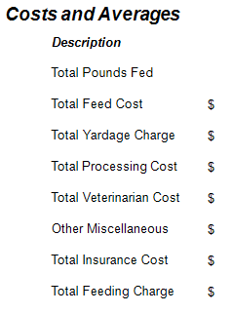
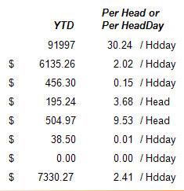
2) Costs & Averages – YTD
“Basis again is head days
IN PERIOD
or headcount.”

Slide 6
3) COMMODITY CREDIT
An owner may pre-pay or deliver a commodity to build his own inventory
of feed to help stabilize feeding costs. The customer receives a credit on their bill
for their personal inventory.
Benefits: Risk is minimized by pre-paying
Personal inventory can be used

Slide 7
4) OWNER INFORMATION
CUSTOMER NAME
Interest charge is financing of cattle and/or feed.

Slide 8
OWNERS AMOUNT TO PAY
MINUS
EQUALS
EQUALS
MINUS
CUSTOMER NAME
PLUS

Slide 9
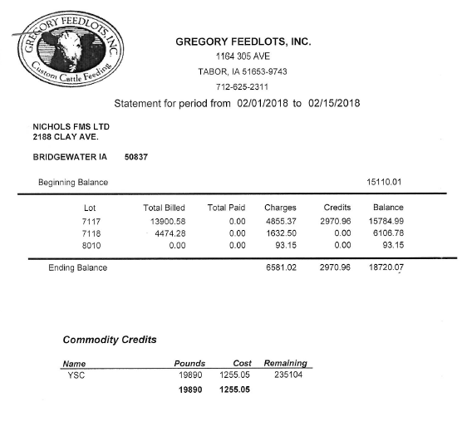
STATEMENT
A statement accompanies
the invoice/s at the end
of each billing cycle.
The statement totals the invoices for a single payable
amount.
The remaining balance for
commodity’s for the billing period.
CUSTOMER NAME
Address
0002
0001
0003
1
2

Slide 10
The charges column
shows your current charges
due for the month and should
match the amounts on the
attached invoices.
Credits applied during the
billing cycle will show in the
credits column. The total should
match payments you sent us
during the billing cycle.
The balance column shows
the total amount you owe for
current billing period and
previous periods.

Slide 11
Thank you for spending time with us today!
If you have questions regarding your monthly bill,
you may contact Carol at 712.625.2311.
If you have questions regarding the bill that were
not answered during this presentation, please send us
a message at faye.french@gregoryfeedlots.com

